Slide 1
Topic : Angle Revision
24
7
30
Date
EQ : What have we learned about angles

Slide 2
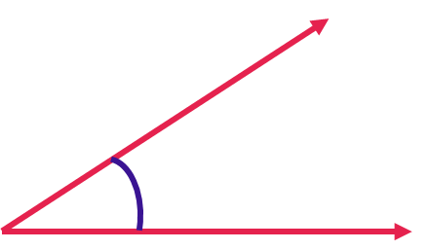
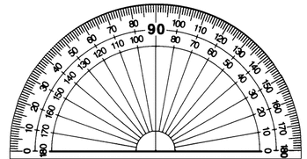
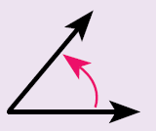
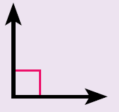
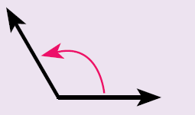
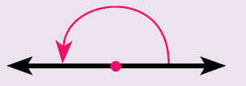
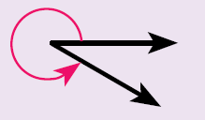
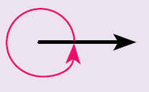
How do we measure angles.
Step 1: Line up the bottom of the angle with the straight line of the protractor.
Step 2: Measure from the bottom arm to the top arm of the angle
Step 3: Read the protractor = 31°
What are the angle types.
Name: Acute angle
Size: less than 90°
Name: Right angle
Size: exactly 90°
Name: Obtuse angle
Size: between 90° and 180 °
Name: Straight angle
Size: exactly 180°
Name: Reflex angle
Size: between 180° and 360°
Name: Revolution angle
Size: exactly 360°

Slide 3
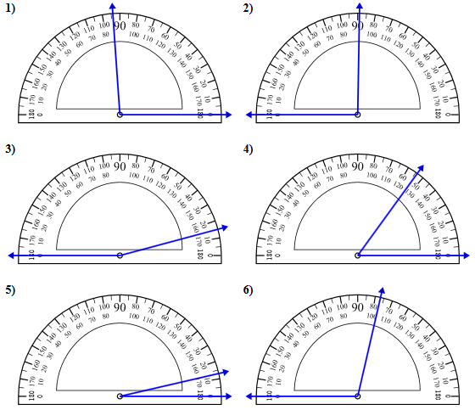
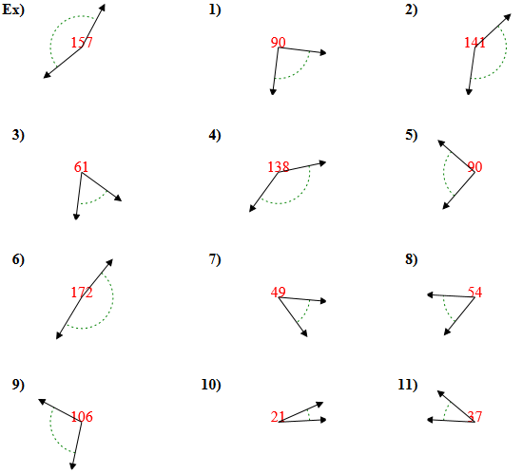

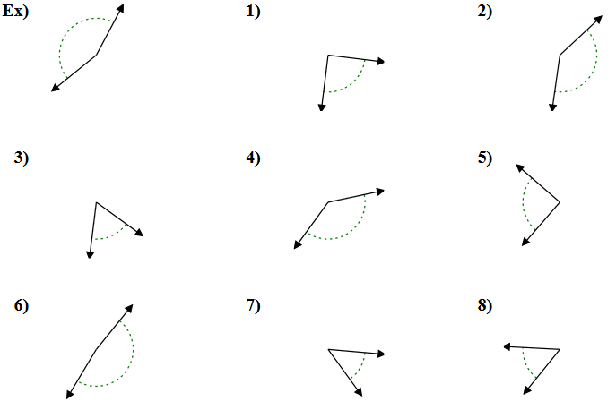

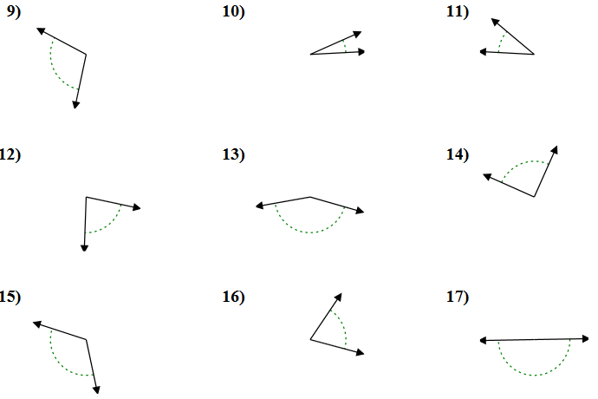

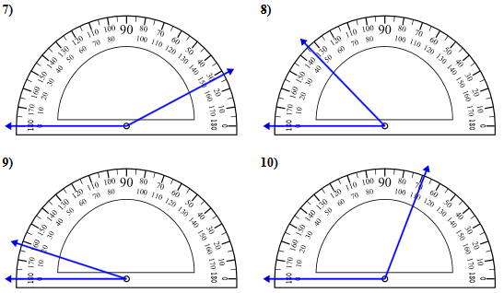
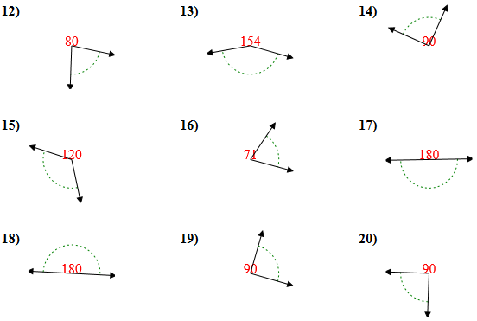


Slide 4
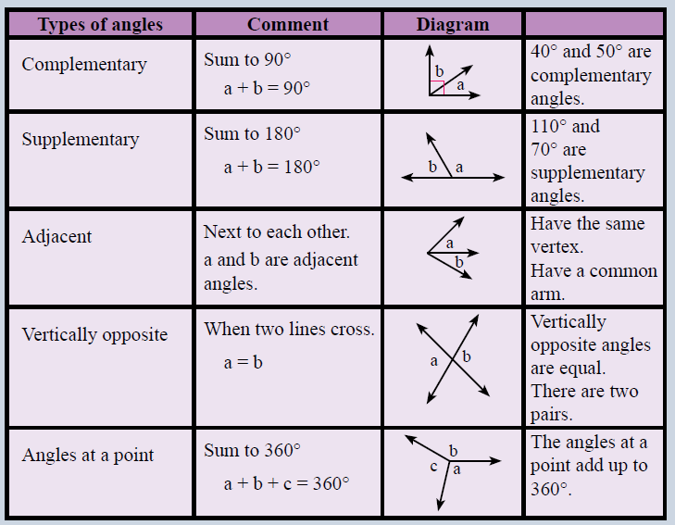

Slide 5
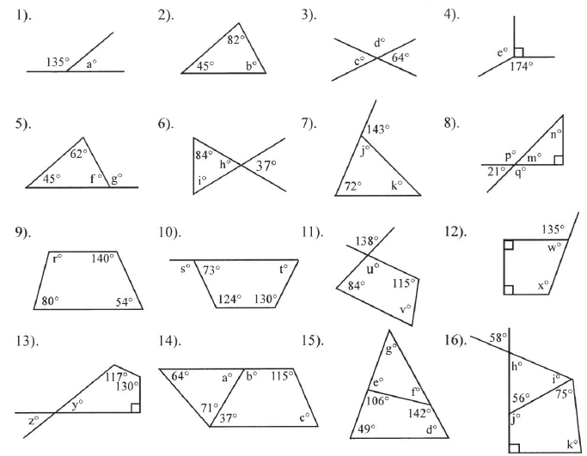

Slide 6
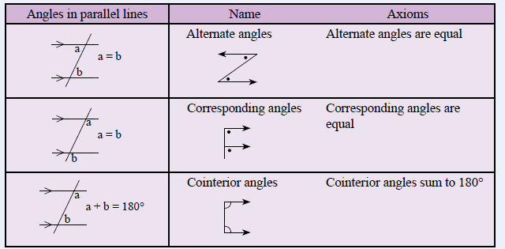

Slide 7
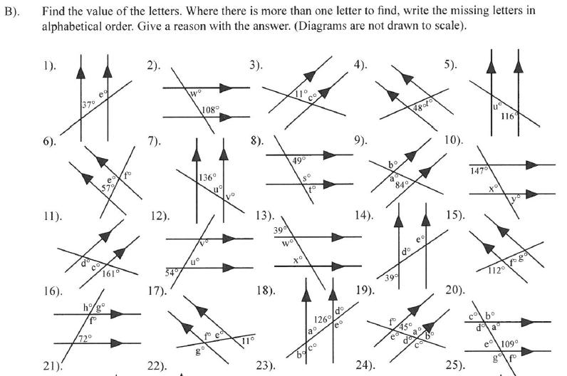

Slide 8
